Slide 1
Analytics for FAST Alumni Network
Basharat Hussain P176102@nu.edu.pk
Tahir Aziz P176054@nu.edu.pk
Supervisor
Mr. Muhammad Amin

Slide 2


Project Progress
Update scrapper
Data Preprocessed
Prototype Analytics Dashboard

Slide 3
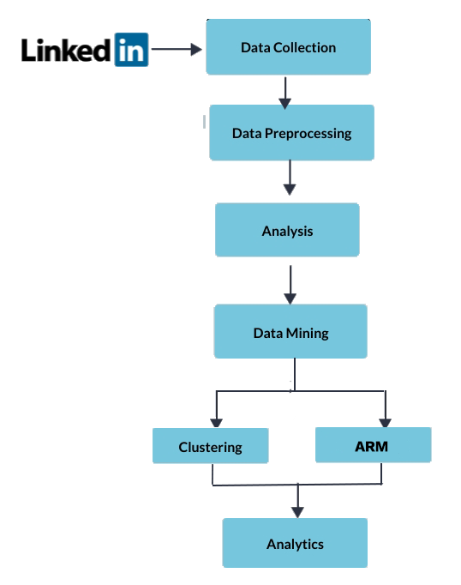
Plan Of Execution

Slide 4
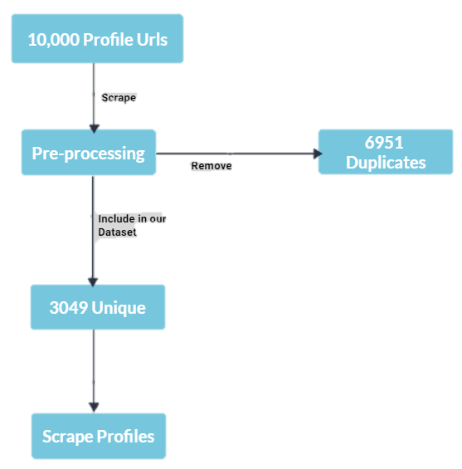
Data Collection
Columns
Name
Current_Company
Current_Job
start_Job_date
experience
Job_location
last_degree
start_date_deg
end_date_deg
last_university
skills
ProfilelDs

Slide 5
New Objectives
Create Analytics Dashboard that shows detail data of our Alumni.
Most common job titles.
Most common employee
Geolocation of Alumni
Most common skills set analytics of alumni.
Alumni clustering on the bases of skill set.(Kmodes Clustering).
Association Rule mining on Skillset.(Apriori Algorithm)
Classification of location for placement based on others attributes.(Decision Tree).

Slide 6
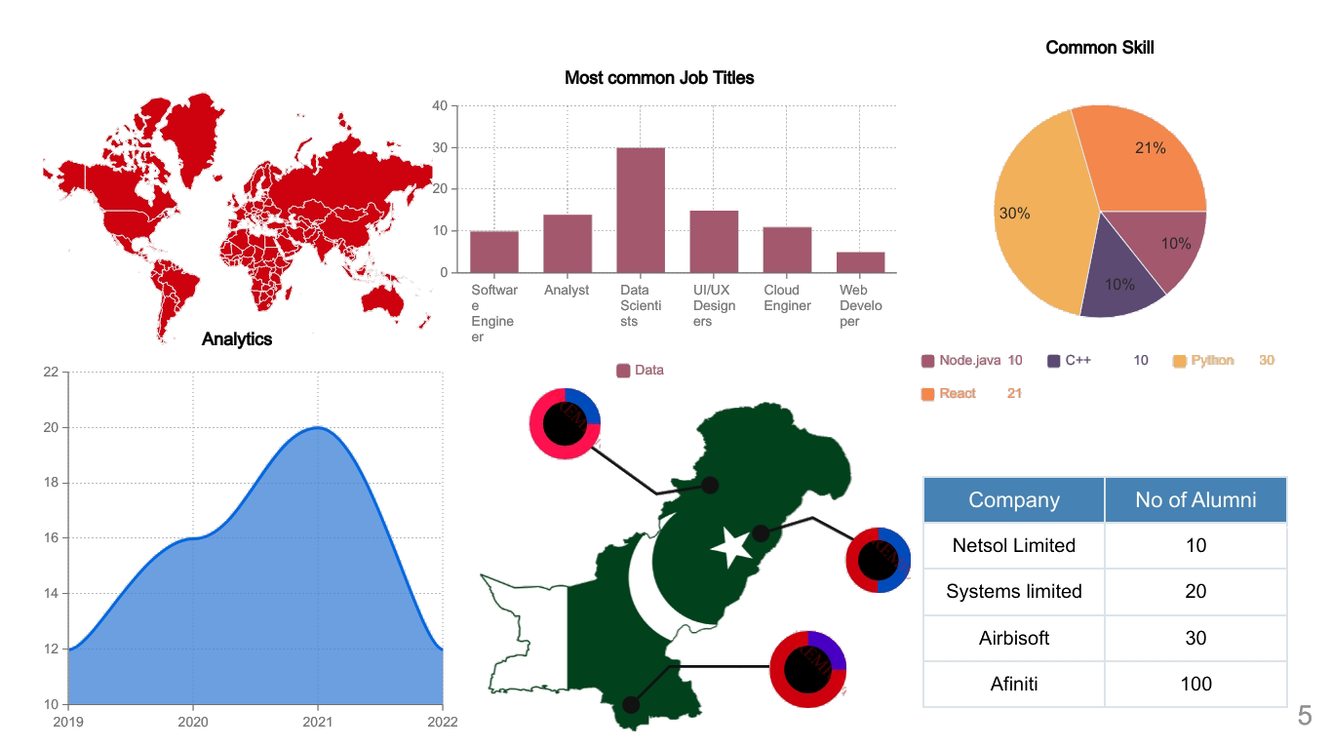
Final Deliverable

Slide 7
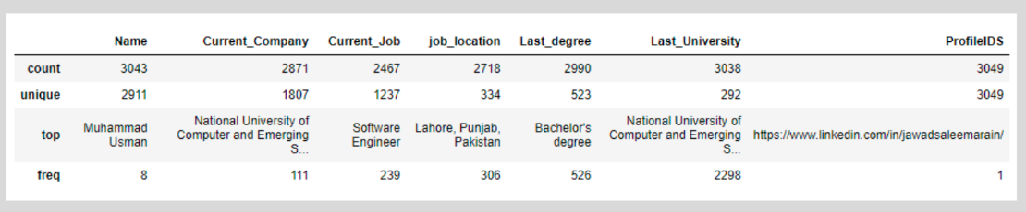
Efficiency
Analytical Summary of final dataset

Slide 8
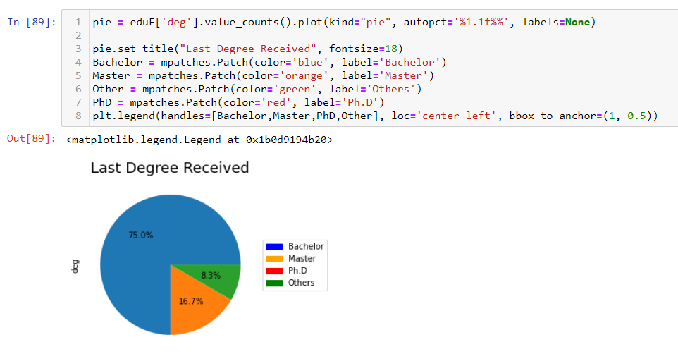
Data Visualization through Python

Slide 9
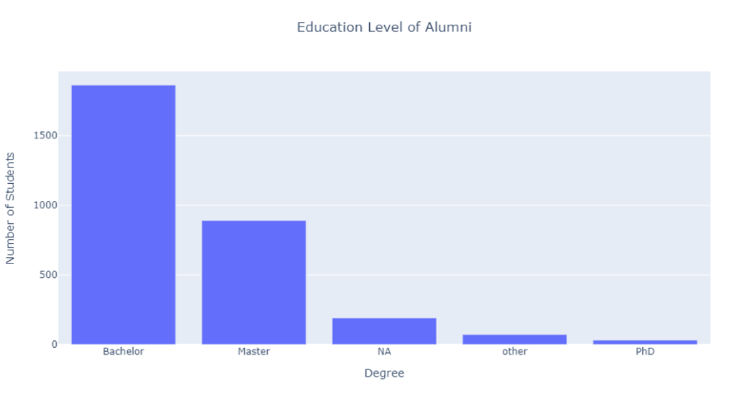
Data Visualization through Python

Slide 10
Limitations
Limited Data
FAST Campus
Complex Predictions

Slide 11
Questions ?

